Slide 1
Understanding Aggregations
22/3/2019

Slide 2
Learning Objectives
What are data and analytical aggregations
Specific aggregation types like mean and median
Why these aggregations are important in today’s world

Slide 3
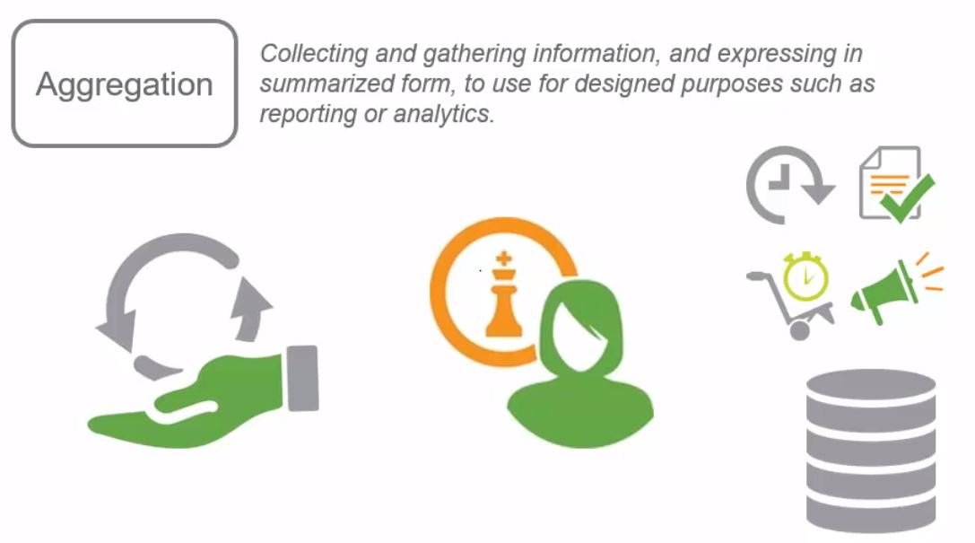
What is Aggregation

Slide 4
Example for Aggregation
Preparing financial reports by a company for various time series, which will help in analytics.
For example, if we want reports for month wise data, we don’t want to look into each transaction happened in those period. Instead, get a summarized report using aggregations and get the final result to do analysis.
In short, aggregation helps an organization to handle large amount of data easier, which then helps to make decisions easier.

Slide 5
Commonly used aggregations
Mean
Median
Mode
Minimum
Maximum
Sum
Count

Slide 6
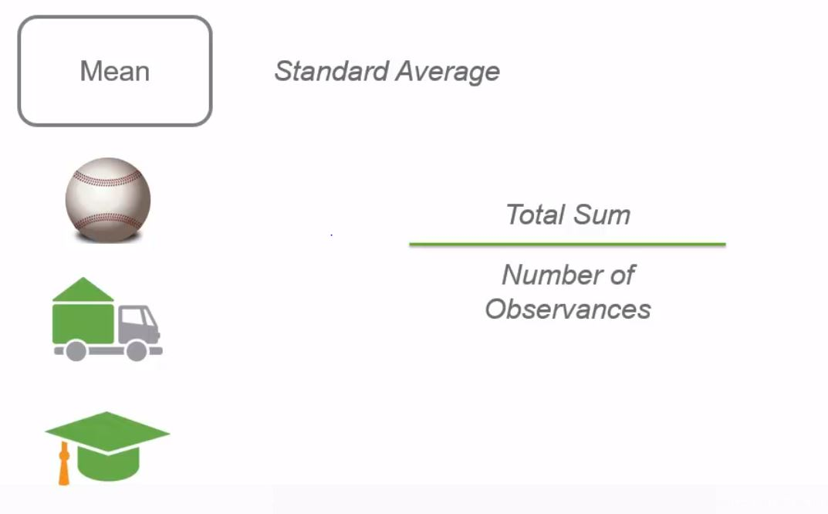
Mean

Slide 7
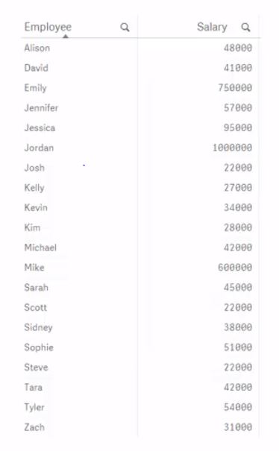
Sample data

Slide 8
Explanation
From the given sample data of 20 employees in a company, we can find the mean(average) salary of the company.
Mean is calculated by dividing the sum of the salary($3,049,000) by the total number of employees(20). The result is $152,450.
The result says that the average salary of the employees working in that company is $152,450. Does it truly replicates the correct picture of the salary in that company?
Let us decide by plotting a bar graph for that given data.

Slide 9
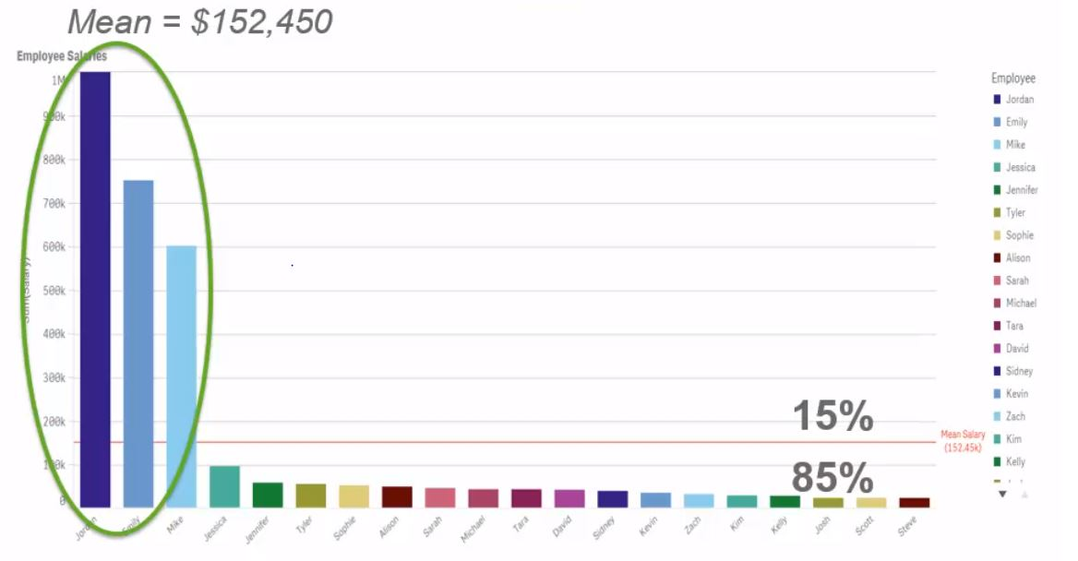
Analysis

Slide 10
Justification
When plotting the graph, it is evident that only 3 employees(15%) gets significantly greater than mean value and the rest(85%) gets very low salary when compared to the mean value.
It is the problem with mean, a potential way to mislead or misuse with this aggregation.
The mean value is greatly affected by that 3 employees who have a greater salary.

Slide 11
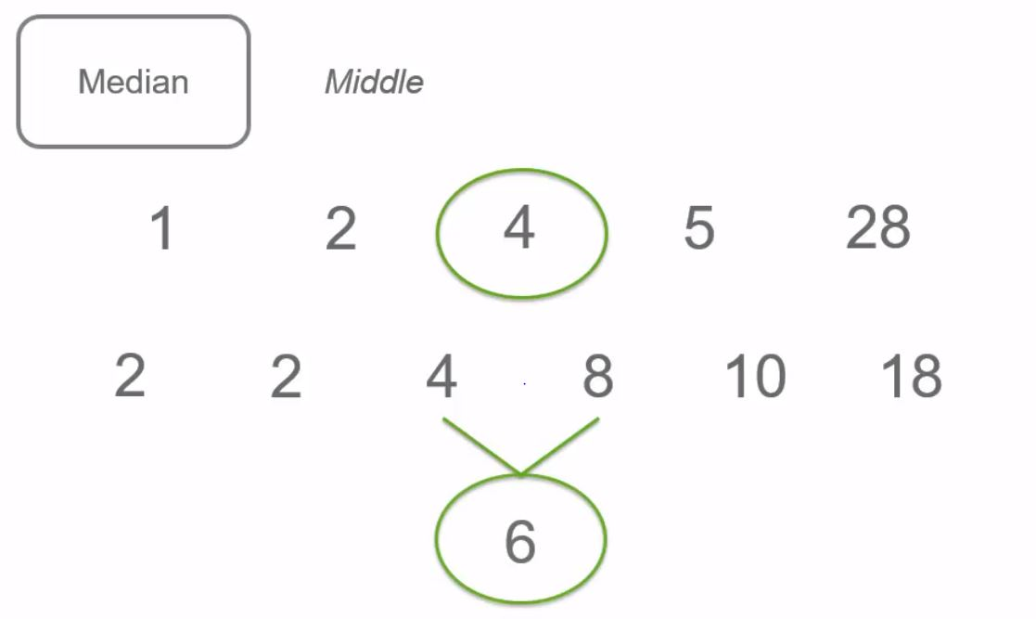
Median

Slide 12
Example
For calculating the median of a data set, the data set have to be ordered first.
The median is calculated by picking the middle element. For even number of data points, the median is the average value of the middle 2 elements.
The median value of the given data set is $42,000
The gap between the mean and the median is $110,450.
The median value is the better representation of the company’s salary.

Slide 13
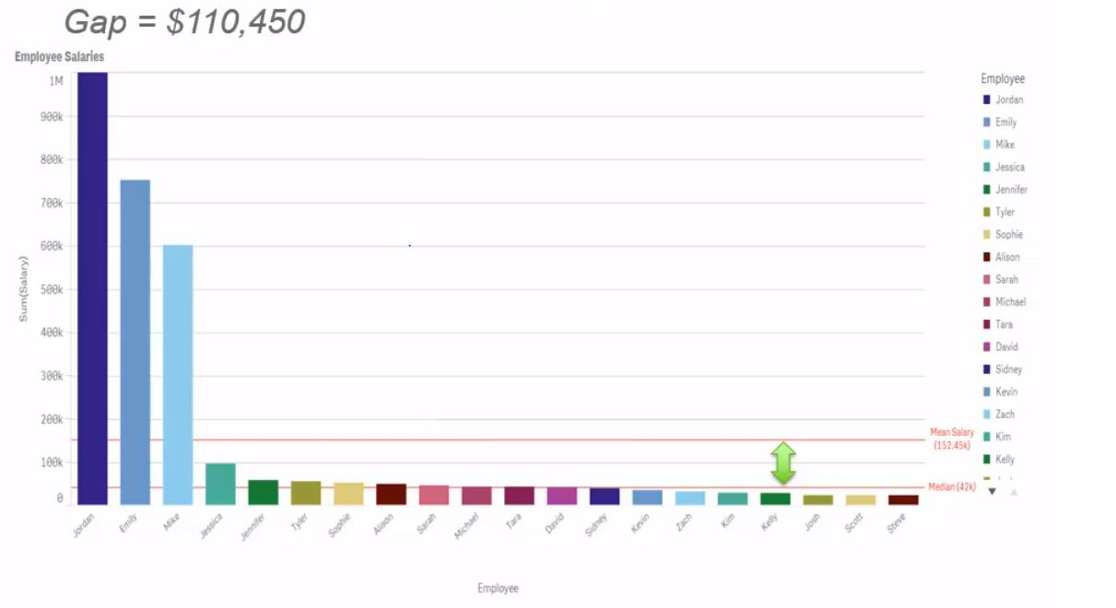
Comparing mean and median

Slide 14
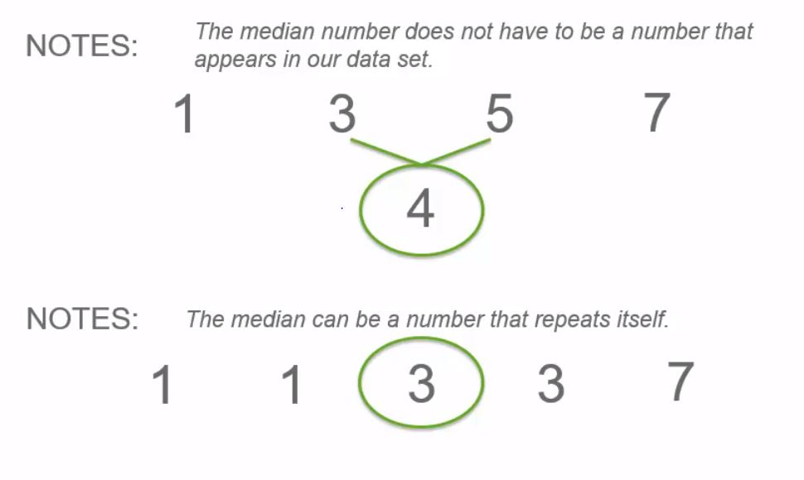
Notes

Slide 15
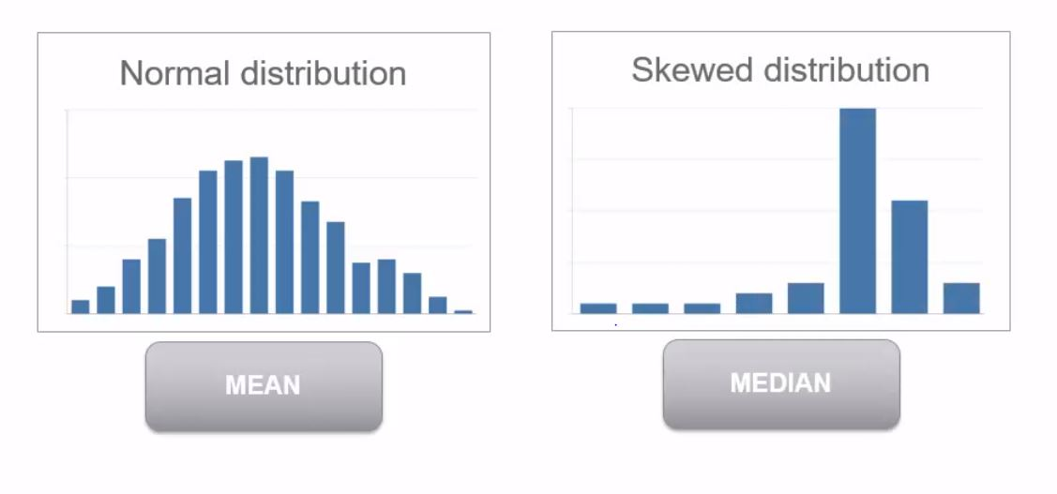
Mean Vs Median

Slide 16
Mean Vs Median
When looking into the data, if the data seems to be in normal or near normal distribution, i.e., without outliers that can skew the results, we can use mean.
If the data seems to be in skewed distribution, we can use median.

Slide 17
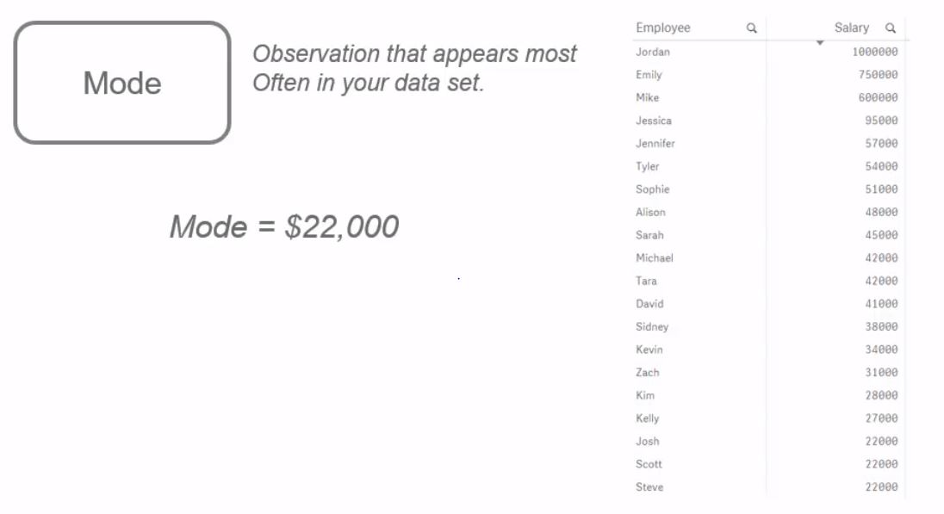
Mode

Slide 18
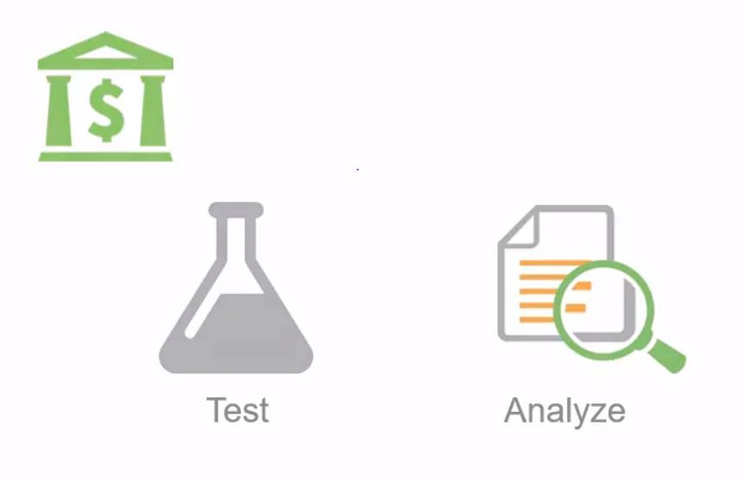
Example #1

Slide 19
Explanation
Mode is the one which does not used often in analysis. For the data set given, the mode will be $22,000 which doesn’t answer any. But mode has some significant properties that can be used somewhere else.
In the above example, a bakery tries to implement new price tag for a particular product. It tests that product with different price tags and analyses the results.
It will look for the price, on which the product is sold for the maximum number of times, and it helps in fixing the price of that product.

Slide 20
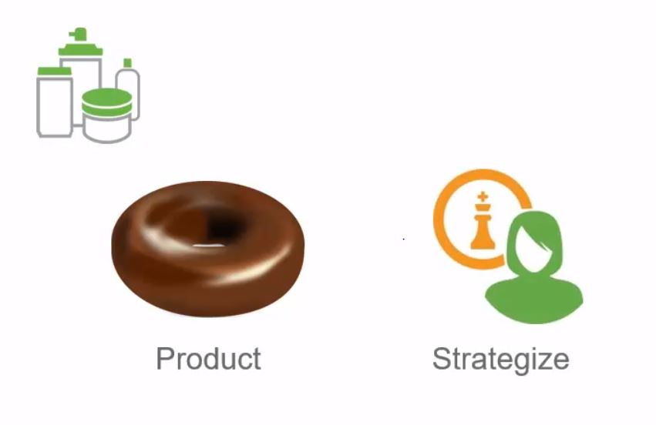
Example #2

Slide 21
Explanation
The next problem is to find how much quantity needed to be baked per day to get the maximum profit.
For this, we need to know the most common amount of product sold per day.
It will then tells us how much we need to bake per day and helps in strategizing.

Slide 22
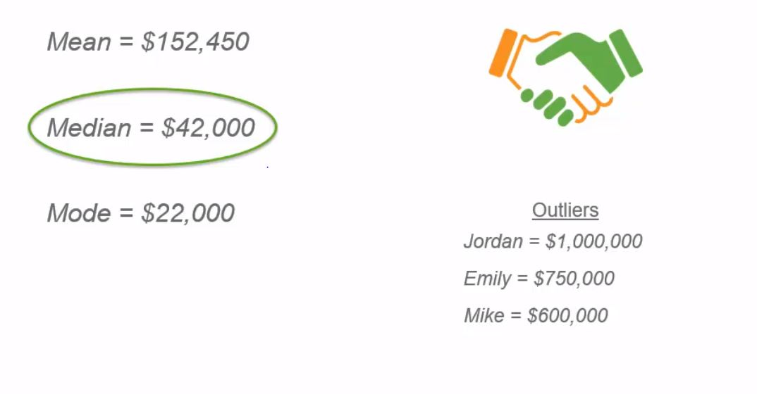
Observation of the given data set

Slide 23
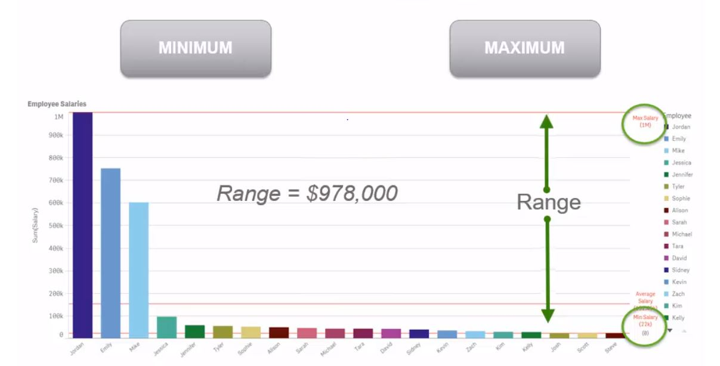
Minimum and maximum

Slide 24
Minimum and maximum
Minimum and maximum is not purely an aggregation, but helps in finding a different aspect called ‘range’
Range is the difference value between the minimum and the maximum value.
The range value for the given data set is $978,000.
It is helpful in identifying the outlier of the data. When the range value is larger, it means outlier is present in the data and can help in eliminating the outliers.

Slide 25
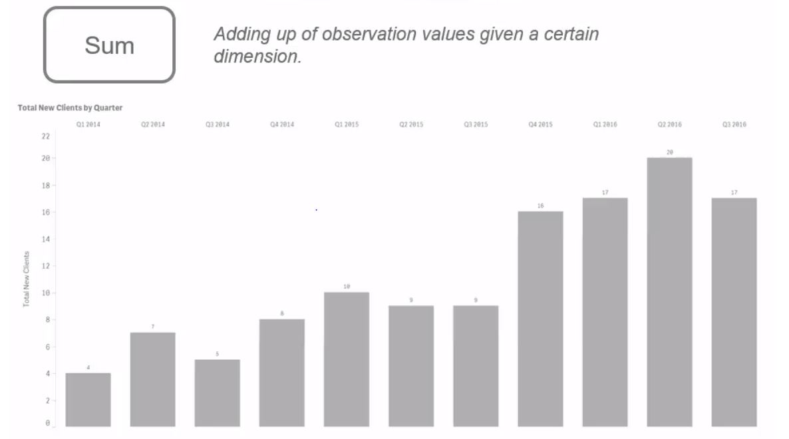
Sum

Slide 26
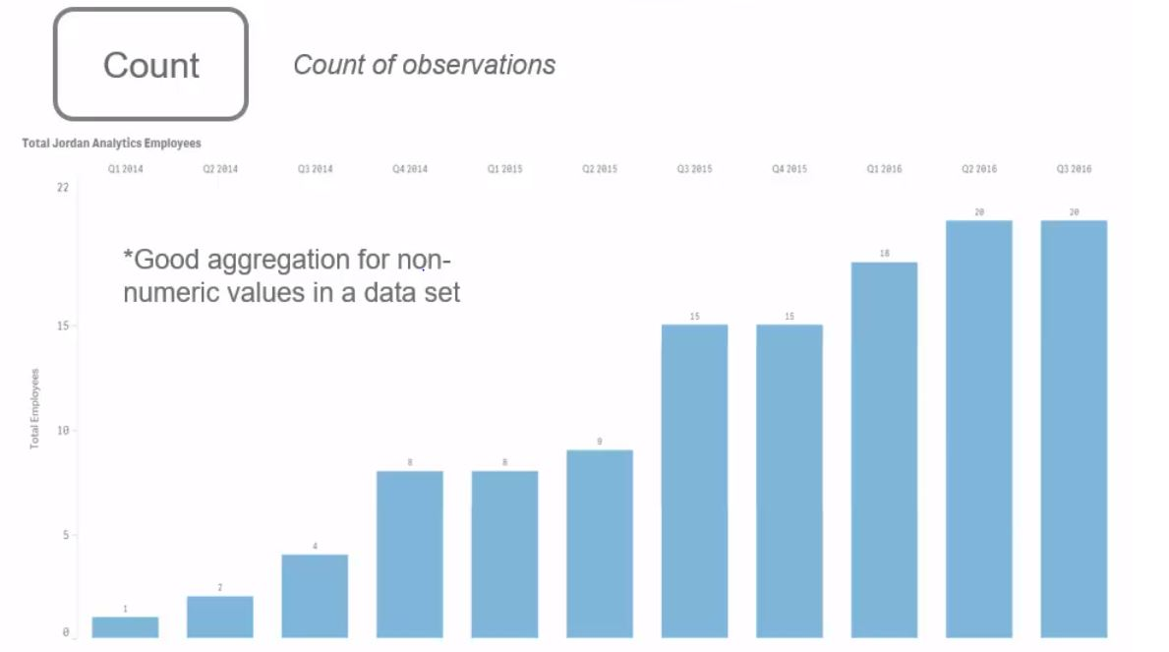
Count

Slide 27
Why this learning is important?
It helps us to simplify, summarize and analyze the large amount of data available.

Slide 28
Quiz
When outliers are found, which type of aggregation will we use show the central tendency of the given set of data?
What is the role of mode in a given data set?
What will we get if we subtract the minimum from the maximum?

Slide 29
Answers
When outliers are found, which type of aggregation will we use show the central tendency of the given set of data? - Median
What is the role of mode in a given data set? – Identifies the most common value.
What will we get if we subtract the minimum from the maximum? - Range

